Slide 1

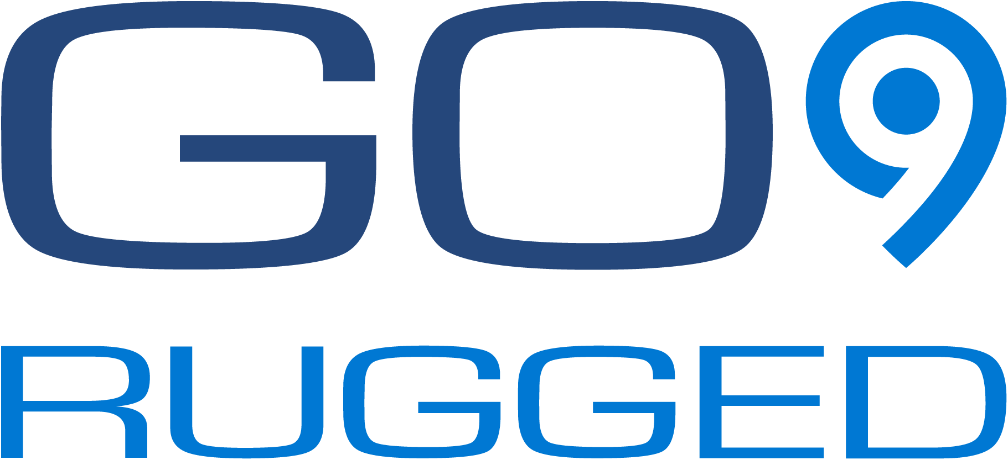
Geotab GO9 Rugged
Product Presentation
T-Mobile, the T logo, Magenta, and the magenta color are registered trademarks of Deutsche Telekom AG. © 2021 T-Mobile USA, Inc.

Slide 2
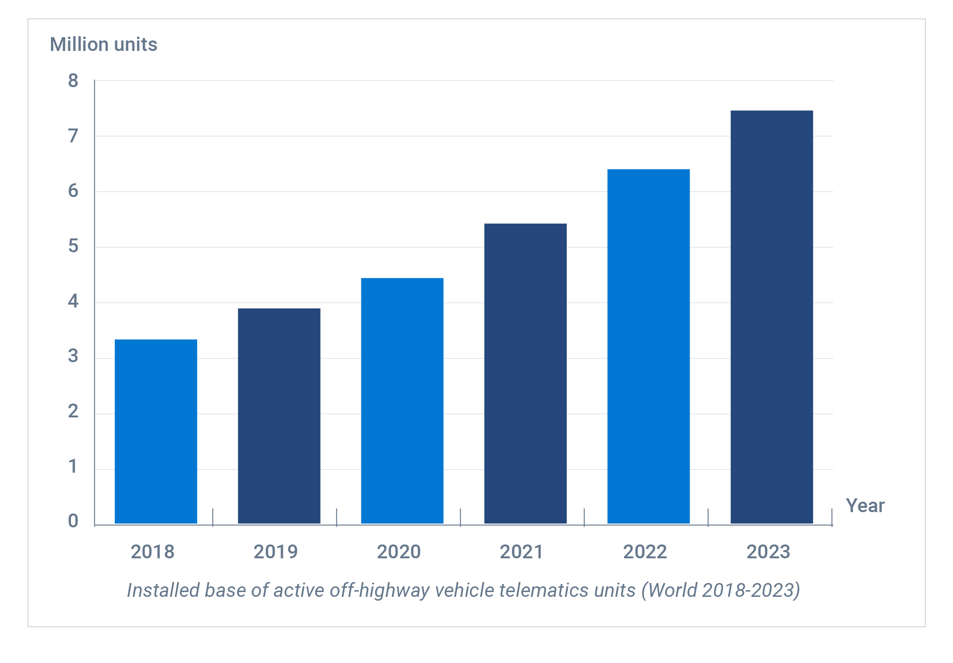
Off Highway Telematics Market
Compound annual growth rate (CAGR) of 17.8%*
“The top-10 equipment manufacturers offering telematics together account for more than 70% of the total number of off-highway vehicle telematics systems in use across the construction, mining, agriculture and forestry sectors globally.”
Rickard Andersson,
Principal Analyst, Berg Insight.

Slide 3
Geotab GO9 Rugged
Section 1: Product Benefits
T-Mobile, the T logo, Magenta, and the magenta color are registered trademarks of Deutsche Telekom AG. © 2021 T-Mobile USA, Inc.

Slide 4
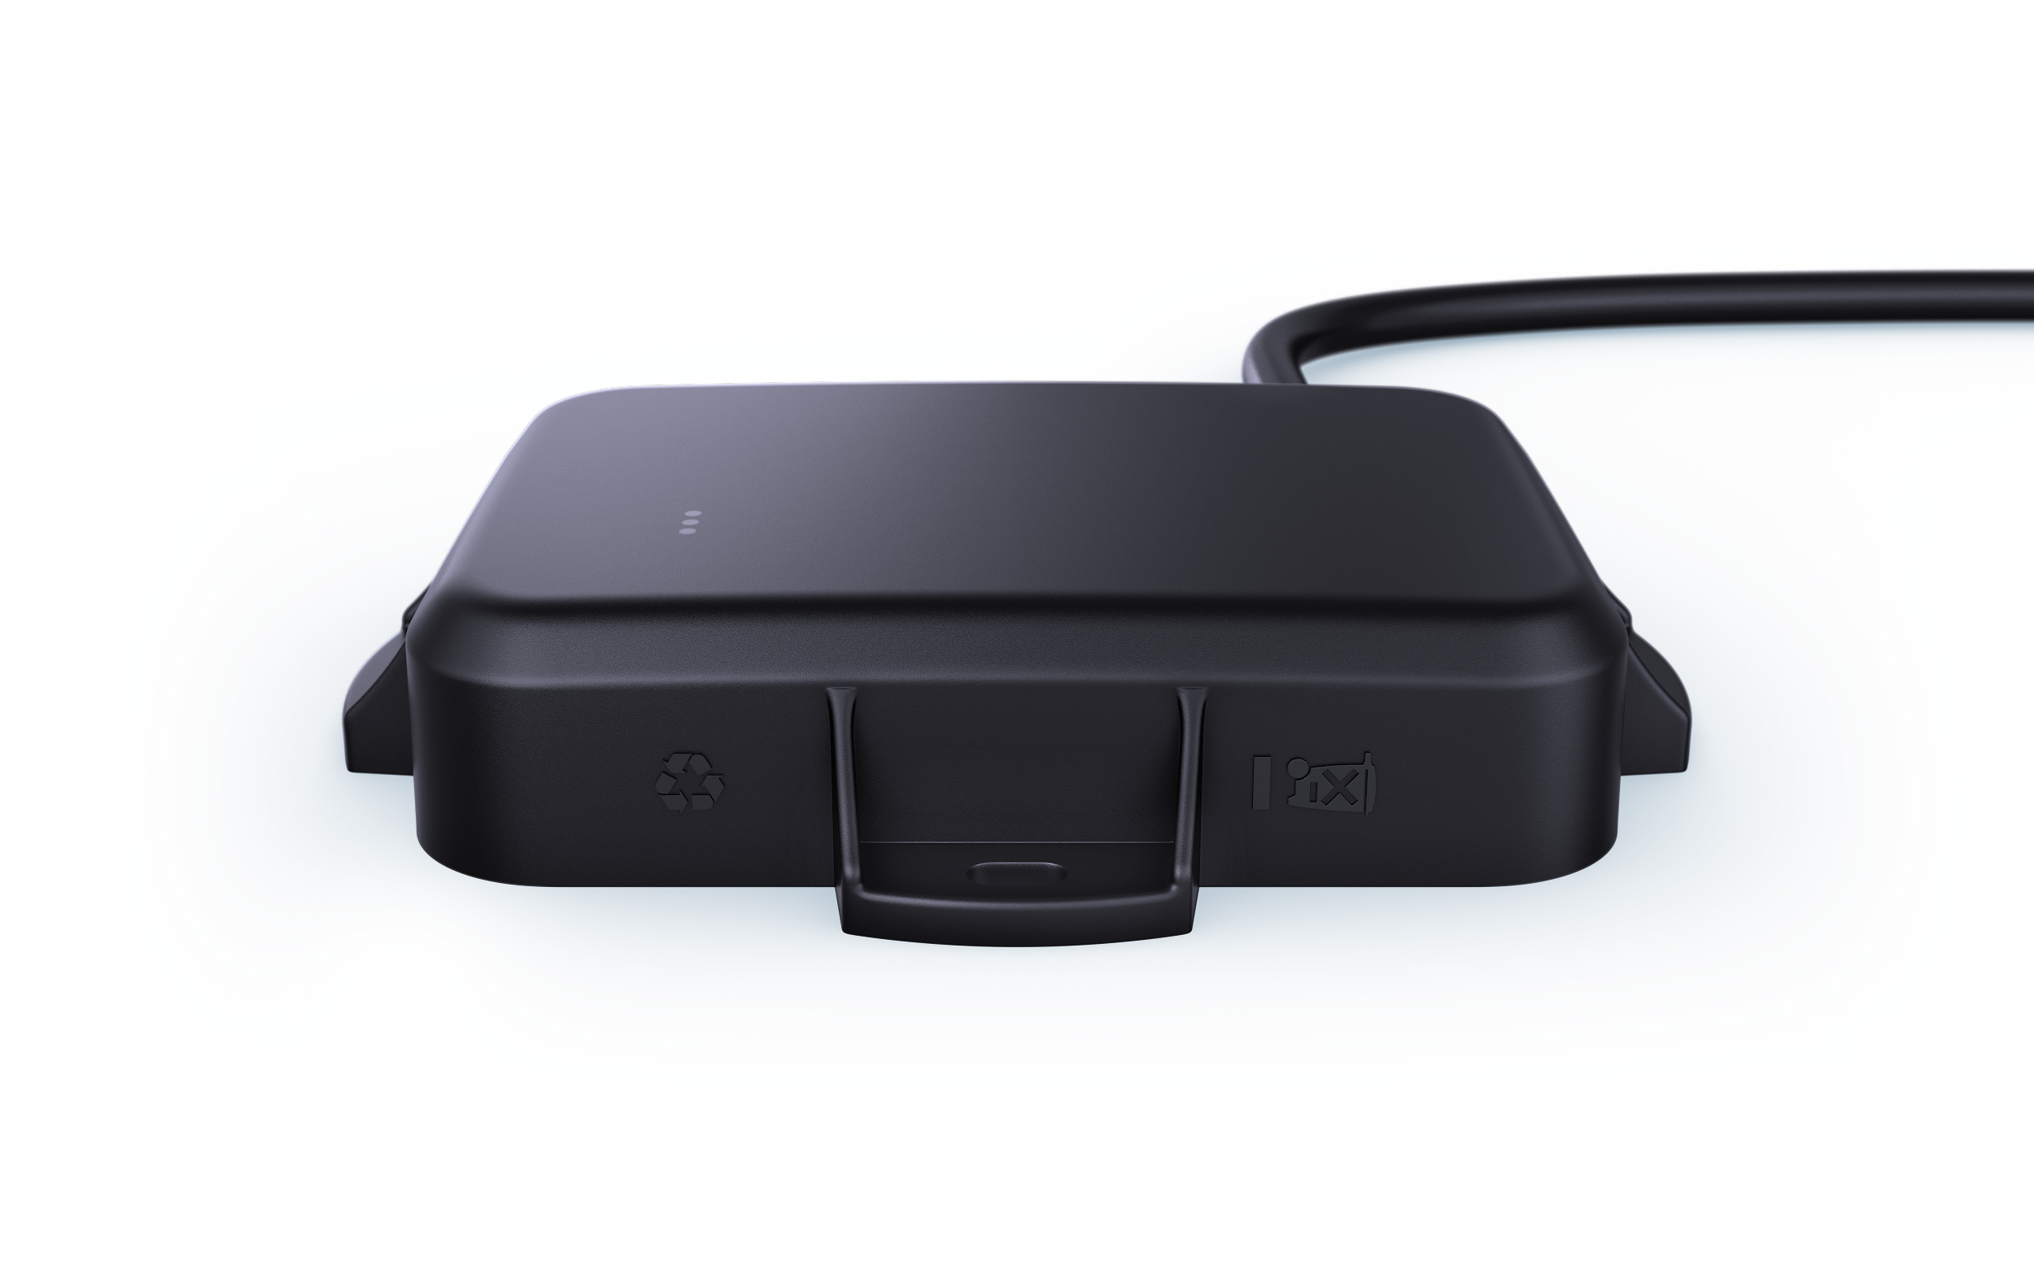
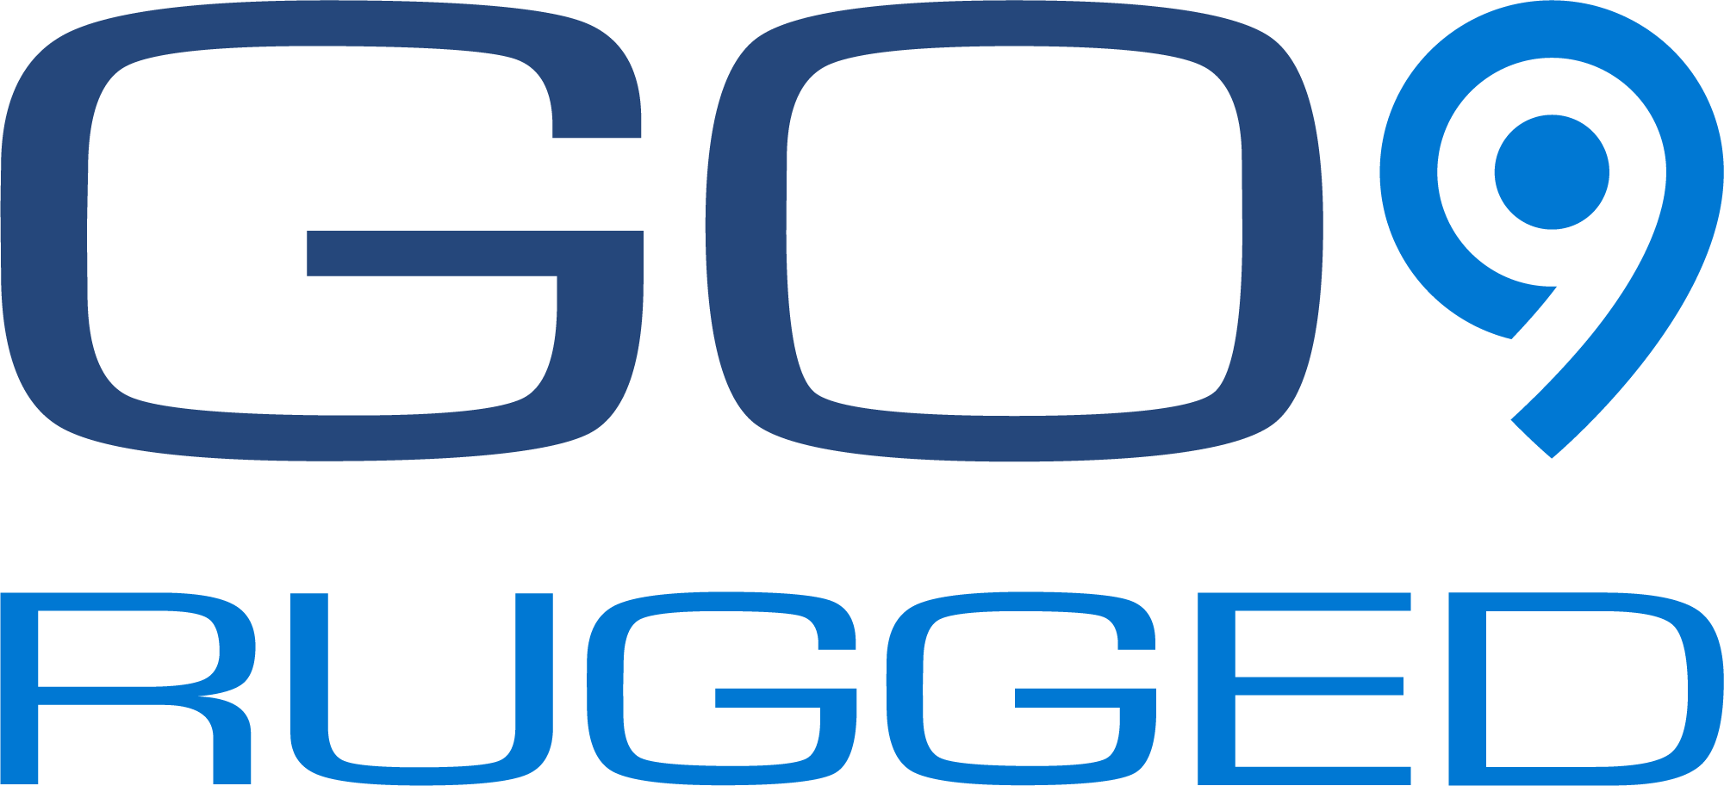
A leading ruggedized telematics device
Reliability in all environments
The GO9 RUGGED is built for harsh conditions and external installation.
Track valuable assets, increase equipment uptime and lower operating costs with Geotab’s innovative open platform.
Ideal for
Heavy equipment
Construction
Utilities
Oil, gas, mining
Agriculture
Powered assets
Trailers and generators

Slide 5

Optimized to work with assets in harsh conditions
Heavy equipment (yellow iron)
Subcompact equipment
(skid steers and mini excavators)
Aerial Work Platforms (Genie, JLG, etc.)
Generators
Compressors
Scissor lifts
Pumps
Anything using diesel
Miscellaneous on-road construction equipment

Slide 6
The GO9 Rugged - Highlights
Stay connected – rain, snow or shine​
Impact, water, and humidity resistant housing, IP68/69K rated.
Operating temperature: -40 to 85°C
Accurate engine diagnostics - support for most major engine protocols.
IOX expandability (ID, operator notifications and more).
Accident detection and notification
Real-time equipment tracking
Over-the-air firmware updates.
External installation supported.
4G LTE Connectivity, 4x more memory and 5x more RAM than previous GO devices
New global Navigation Satellite System (GNSS) module (GLONASS+GPS support)

Slide 7

IOX Expandability
Unlimited flexibility to address changing fleet needs
Daisy chain up to 5 IOX
Hardware SDK lets partners create own unique IOX
Asset tracking using Bluetooth beacon monitoring
Donaldson Filter Minder and TPMS integrations
Europe: Vehicle inspections, Duty of Care,
personal vs. business use
Auxiliaries - 2 sets of 4 digital inputs
Add-on device integration through USB, RS-232,
CAN and BLE protocols
CAN messaging (can monitor 2 CANs at once)

Slide 8
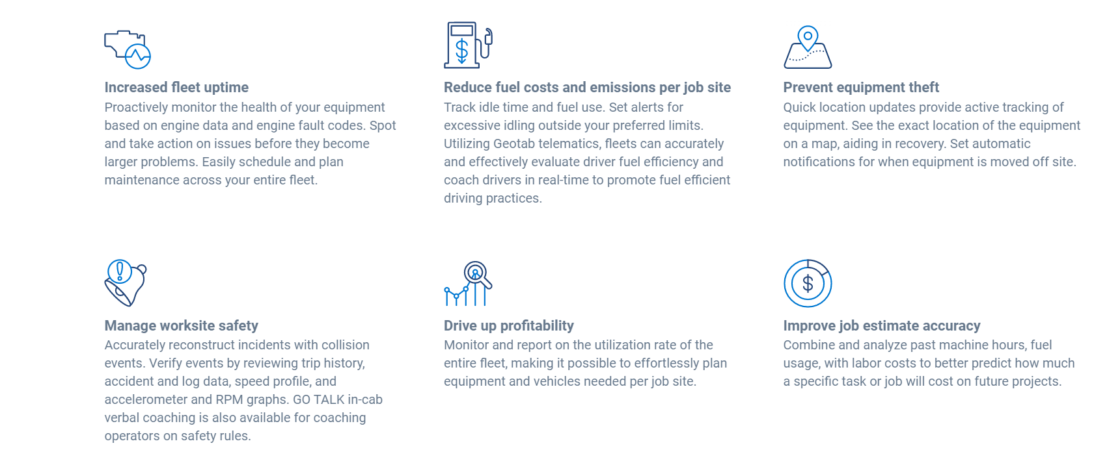
Benefits of off-road tracking

Slide 9
Geotab GO9 Rugged
Section 2: Geotab Platform
T-Mobile, the T logo, Magenta, and the magenta color are registered trademarks of Deutsche Telekom AG. © 2021 T-Mobile USA, Inc.

Slide 10
Mixed Fleet Strategy
Needs assessment
Hardware
  GO9 and GO9 RUGGED devices
  IOX for CAN messaging, 3 wire hook up and additional hookups
  Ecosystem products like Dash cams and Asset trackers
Rate Plans
  Base (Location and hours)
  Pro
  ProPlus
Support System
  AEMP standard API’s with business integration
  T-Mobile and Geotab solution engineers help companies evaluate, design and implement a mixed fleet strategy
Evaluation
Design
Implementation
Launch
Notes:
Geotab+TMO support mixed fleets (vehicles, construction machinery and critical assets) from a singular Geotab platform. Working directly with the businesses, Geotab+TMO will make the best recommendations that help you meet your fleet compliance needs, while avoiding risk. Flexible solutions can include our IOX products that extend functionality (IOX-GOTALK) and help to promote safety and risk reduction (dash cams and asset trackers). Together, Geotab+TMO help companies with the best telematics solutions that meets their needs and supports their growth.

Slide 11

Unique Open Platform
Seamless access to your own data
Build and automate with our powerful Software Development Kit and APIs
Integration matters
One platform to log in for all data from your on-road or off-road assets
Notes:
systems which is quickly becoming key for companies looking for smart building technologies.

Slide 12
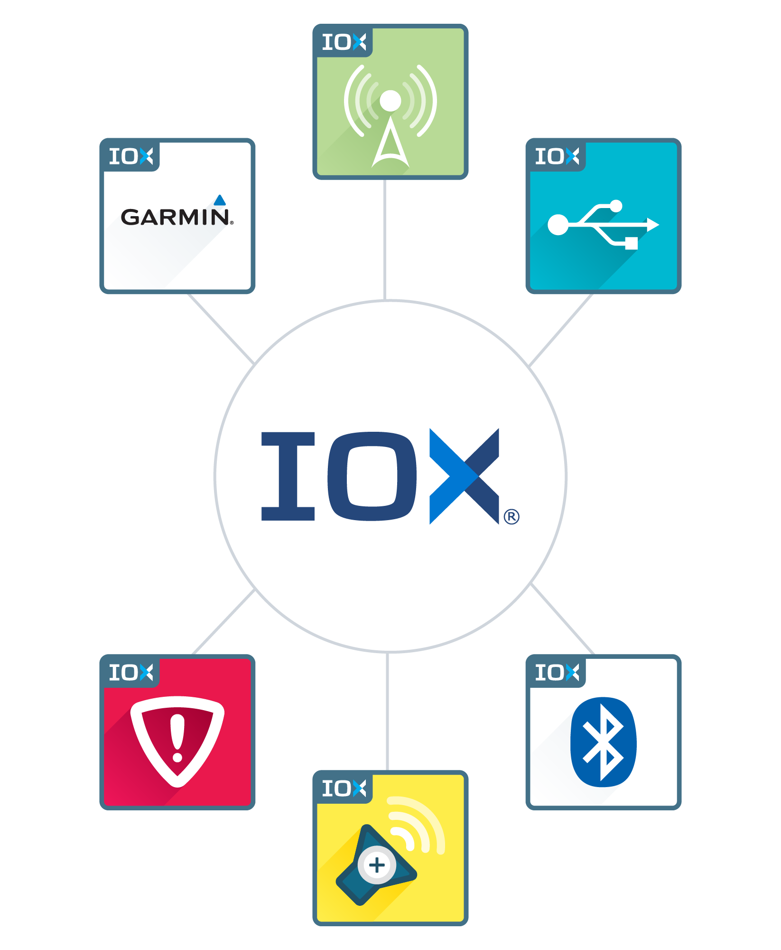
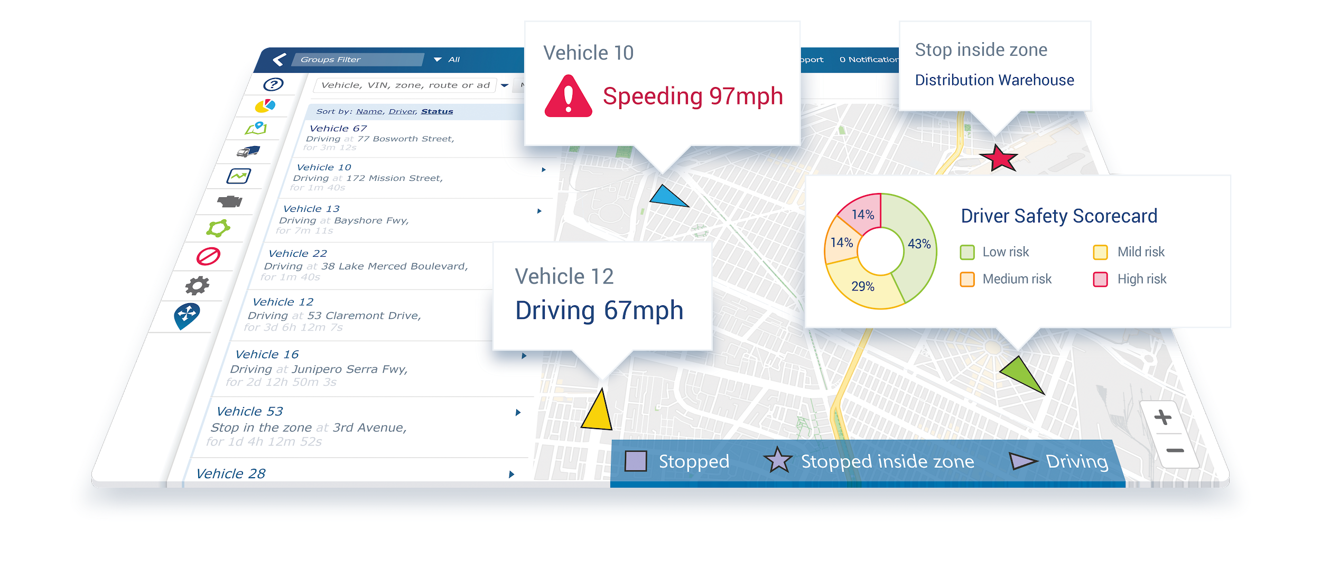
Expandability
World-class API with docs and code samples
Hardware SDK
Write Add-ins to extend MyGeotab
Use individual MyGeotab pages in its own systems
MyGeotab uses the SDK for our UI

Slide 13








Geotab / T-Mobile Advantages
Open platform
Hardware Agnostic
Curve logging
One device for all plans
Electric power monitoring
SDK
FIPS 140.2 security designation
Largest high speed national wireless network

Slide 14
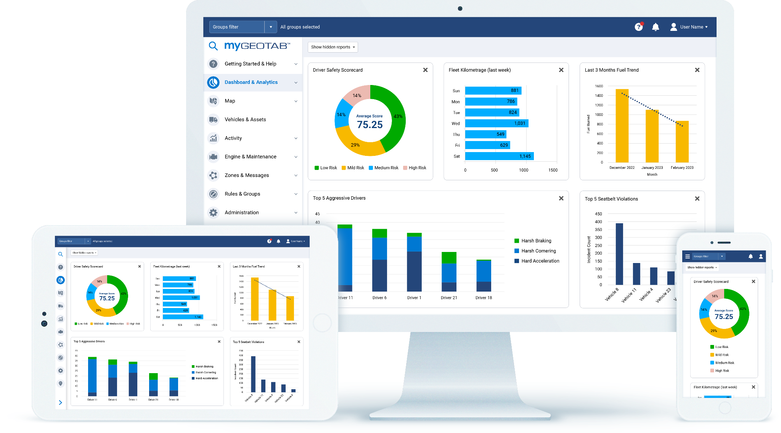
Marketplace Custom Reports
Last 3 Months Idling Trend Report
Fleet Savings Summary
Weekly Idle Cost
Diagnostics & Malfunctions by Vehicle
Telematics Device Issue
Detection Report

Slide 15


The T-Mobile IoT advantage
Network
Multiple network technologies to meet any IoT use case today, including on our amazing 5G network.
We bring a simple approach to solving complex challenges.
Customer experience
  Amazing customer experience, from design to deployment, for customers of all sizes.
Business value
Portfolio of ready-to-deploy or custom applications to ensure your IoT solution delivers value to your business.
Coverage not available everywhere. Qualifying business account, service, and capable device required. Restrictions apply.
Notes:
Why T-Mobile?
We consult with you to architect an IoT solution that accomplishes your desired goals.
While we are the 5G network leader, we deploy multiple network technologies to ensure your IoT solution does not lose connectivity
We leverage our industry-leading customer experience to design and implement IoT initiatives for customers of all sizes across multiple industries
We offer a suite of solutions, from ready-to-deploy to custom applications, so you get a tested IoT solution that drives value to your business.
At the end of day, we take the guesswork out of creating and deploying an IoT strategy, simplifying the journey so you can fuel your growth.

